Slide 1
The Importance of Tests
David Sackstein

Slide 2
Overview
In this module we will learn why tests are so important. Verification is the obvious benefit, but there are many more.
We will describe different levels of tests: Unit Tests, Integration Tests, System Tests. Everyone does System Testing (hopefully) but is that enough? Building on Module 1 we will learn what makes code testable and we will consider the benefits of Dependency Injection, Mocks and Stubs.
It is all actually much simpler than it may sound, and I will demonstrate with code examples to prove it.

Slide 3
Agenda
Why do we need tests?
What are good tests?
Types of tests
How do we make code testable?
Introducing GoogleTest
Dependency Injection
Mocks and stubs
Testability challenges and the options you have

Slide 4
Why do we need tests?
To verify that the code works as expected
To step the code for debugging
To document usage of the code
To lock in certain functionality so we can make changes safely
To force us to use good design principles, in particularly
Decoupling
Clear interfaces

Slide 5
What are good tests?
Test should be F-I-R-S-T
Fast
Independent
Repeatable
Self-validating
Timely

Slide 6
Types of tests
Unit test
Test a function of set of functions usually of one class.
Component test
Tests an entire component, mocking interactions with other components
Integration test
Tests the interaction between components.
Functional test (or end-to-end)
Tests the entire functionality of flow as used by the user.
Characteristic Tests: Coming up in Legacy Code

Slide 7
How do we make code testable?
Apply the principles we have learned so far:
Components should be small
Components should have one responsibility
Components should have a clear interface
Implement Dependency Injection
Dependencies should be provided as arguments to the constructor and not modified.
They should preferably be references or const pointers so they cannot be reassigned.

Slide 8
Test driven development
TDD takes testing a step further.
Write failing tests (Red)
Write the code to make the tests pass (Green)
Refactor, if necessary (keep Green)
Go to 1
TDD ensures good test coverage
Sometimes the rigid ritual it is not justified
It is another tool in your toolbox

Slide 9
Google Test
A C++ unit testing framework by Google (gtest)
It does not require any changes to your code
Can also be used for other test type
This depends a lot on your design
It provides:
Integrated test discovery and execution
Assertions for comparing values
Stand alone tests without context
Test fixtures with setup/teardown
Google Mock provides simple mocks and stubs
I recommend you write your own!

Slide 10
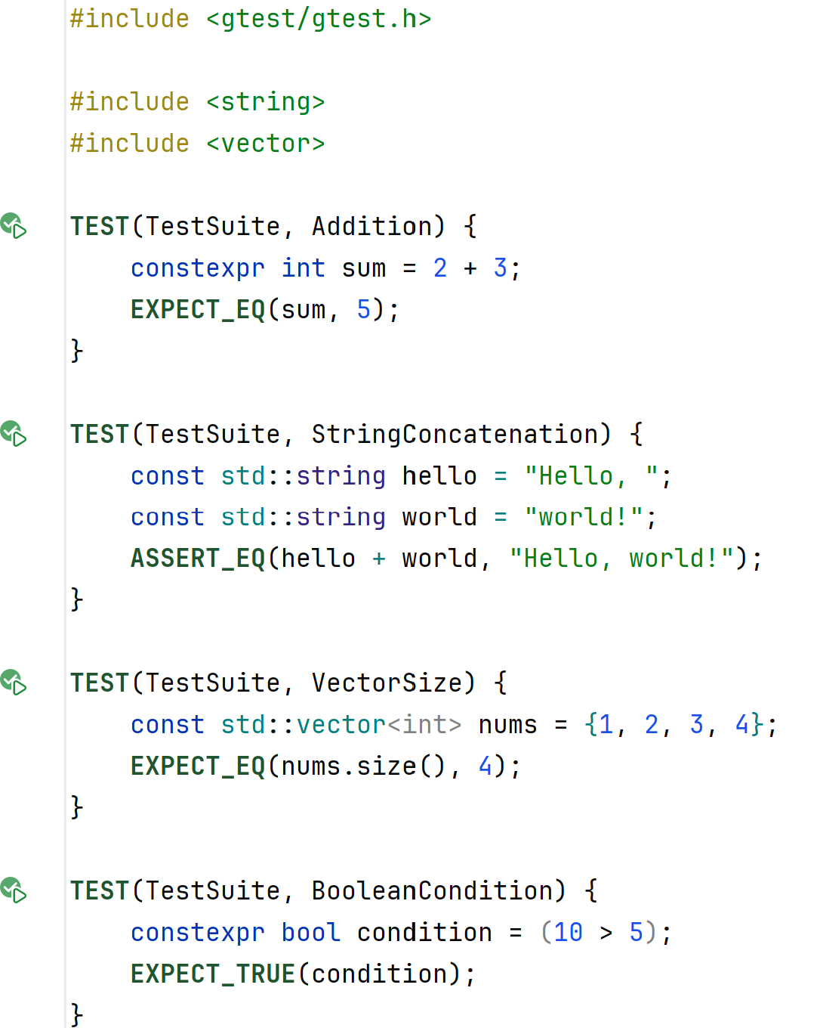
The only include you need
The TEST macro defines a suite name and a test name
Assertions abort the test if they fail
Expectations allow the test to continue if they fail

Slide 11
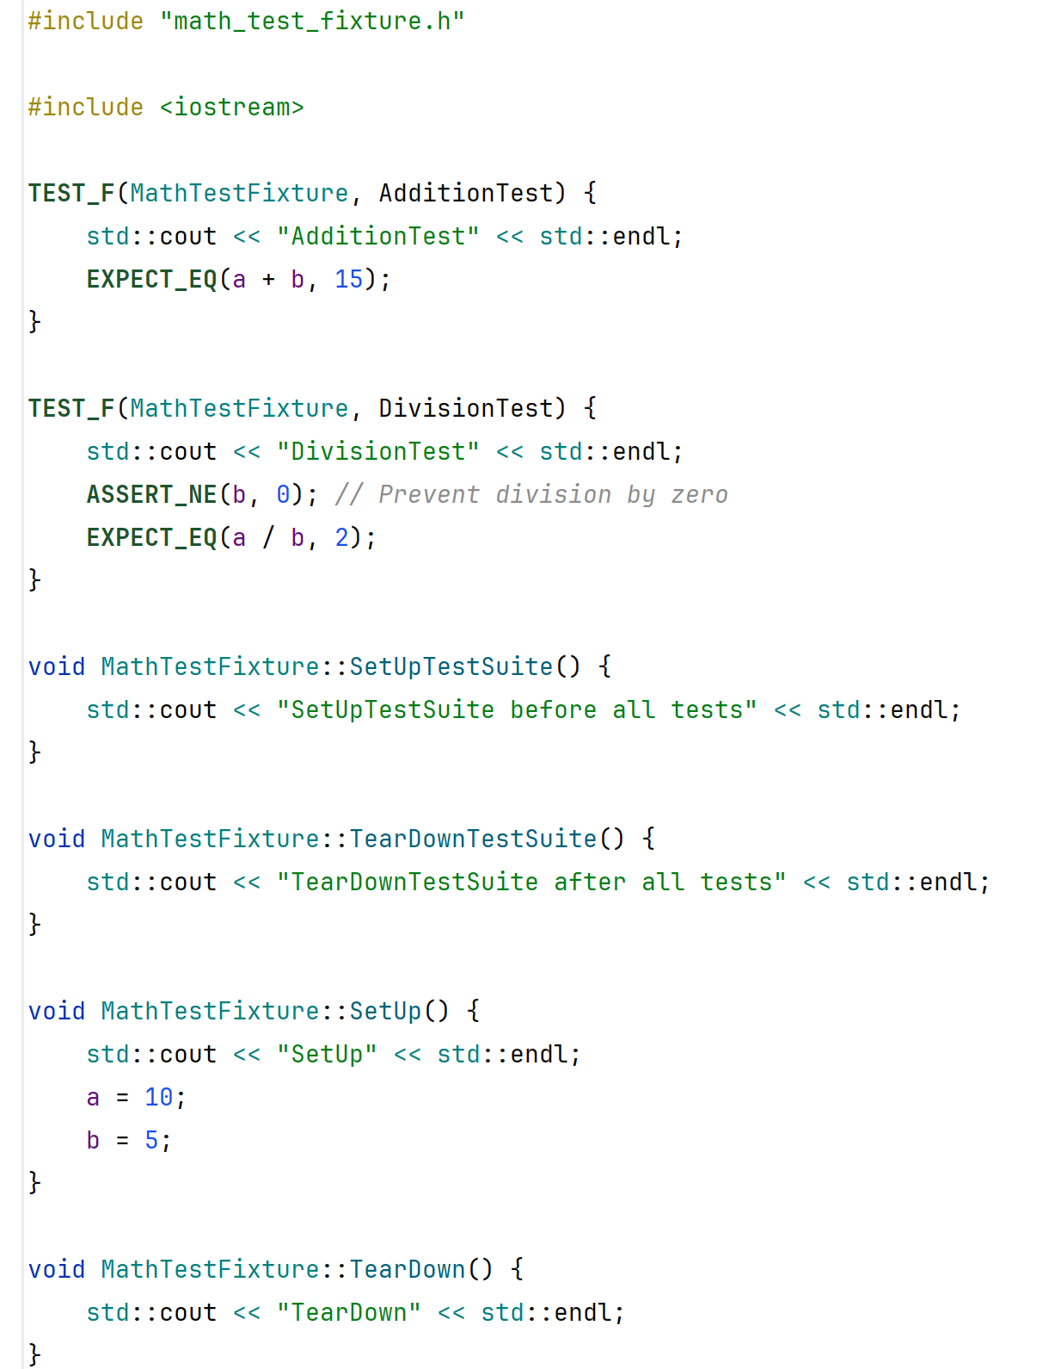
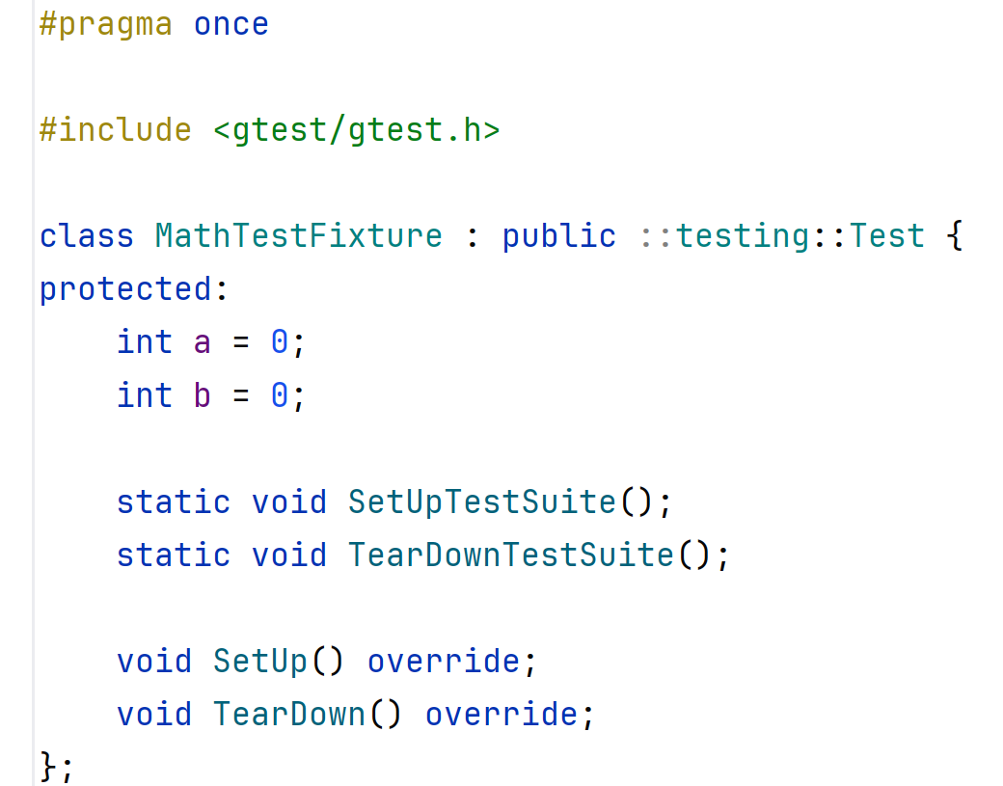
Define the fixture as a class in the header
The TEST_F macro defines a test name in a fixture
SetupSuite/TearDownSuite are called before and after the entire fixture
Setup/TearDown are called before and after each test

Slide 12
Dependency Injection
Dependency Injection is a key development technique that improves testability and extensibility.
Rather than depending on concrete classes, depend on interfaces.
The interfaces are passed into the ctor and stored as immutable fields.
This is how we implemented Composition in Prefer Composition over Inheritance

Slide 13
Dependency Injection: Benefits
Implementations can be changed without changing the class that uses them.
This allows you to extend the code easily.
It also allows you to replace real implementations with mocks and stubs.
This makes your class testable.
Note: testability is often a motivation for improving design

Slide 14
Mocks and Stubs: The Problem
Testing requires the ability to run a class in an isolated environment.
This requires separation between the class and its environment.
But if the class is coupled with databases, files, and other classes, this is very difficult.
As a result, you need to set up all the dependencies in order to test the class.
Apart from the setup complexity it also makes the tests run slowly.

Slide 15
Mocks and Stubs: The Solution
If the dependencies are interfaces, you can supply a special implementation that does the minimum required to allow the test to pass.
This is ideal for dependencies that do not change the behavior of the class (a logger, for instance).
These are stubs:
A stub is a minimal implementation of an interface that is sufficient to allow a class to run in a test environment.

Slide 16
Mocks and Stubs: Another Problem
Tests call the public API of a class and verify functional behavior.
But how do we test the private methods? Do we need to?
One solution:
Extract a class in which the private methods become the public methods of the extracted class. These methods can be tested.
Note: Tests are again a motivation to improve design
Another solution is to write mocks.

Slide 17
Mocks are like spies
A mock is an implementation of a dependency interface that maintains a state.
It can record arguments that are passed to its methods, react in different ways to those methods.
Moreover, it is useful to program a mock to exercise certain behaviors. (Error injection)
And we can query it after the test to verify how it was invoked during the test.

Slide 18
Testability challenges and solutions
How can I test private methods?
Use a mock or extract a class (discussed above)
Methods that call sleep are not fast.
Avoid using sleep where possible
Stub the sleep function to do nothing
Or increment a time variable, if you need to know the time elsewhere

Slide 19
Testability challenges and solutions
Methods that depend on time may not be repeatable.
Try not to depend on time
Instead of requesting the time, accept time as a parameter. Push the problem up in the call stack.
If you must request the time, provide the clock as an interface and mock it.
You may want to define a mock that provides immediate responses to sleep(), gettime(), wait() and so on.

Slide 20
Testability challenges and solutions
Classes that run concurrent tasks may not be repeatable.
Do you really need concurrency? (I have to ask)
Push concurrency as high up as possible in the call stack, keeping the core logic single threaded and repeatable.
Focus on the non-concurrent parts and test different possible orderings that are repeatable.

Slide 21
Agenda
Why do we need tests?
What are good tests?
Types of tests
How do we make code testable?
Introducing GoogleTest
Dependency Injection
Mocks and stubs
Testability challenges and the options you have

Slide 22
Key Takeaways
Why test? | Verification, debugging, documentation and design
Which framework? | Choose a framework that does not force you to change your code (e.g. gtest)
Testability | Use good design principles and use dependency injection, mocks and stubs
Private methods? | Must be tested too. Use class extraction to make them public or use mocks.
Good tests | Should be F.I.R.S.T. Test Driven Development is not a must

